Slide 1
Tutorial 7

Slide 2
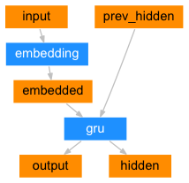
The Encoder

Slide 3
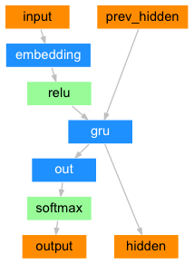
The Decoder

